Slide 1


The website in html and css
Take the role of the developer and create everything all steps of the way
from the first code until you have a finished website.

Slide 2
Lecture 1: Introduction
The project, resources and materials

Slide 3

You are about to develop a website for
an imaginary restaurant called Eos Café
Notes:
The restaurant manager at the imaginary restaurant Eos Café needs an online, visual profile. A website. He has hired a photographer to take nice photos of the restaurant’s dishes, a web designer to create a simple, professional web design, and a web developer to convert that design into a functional website. You are this web developer.

Slide 4
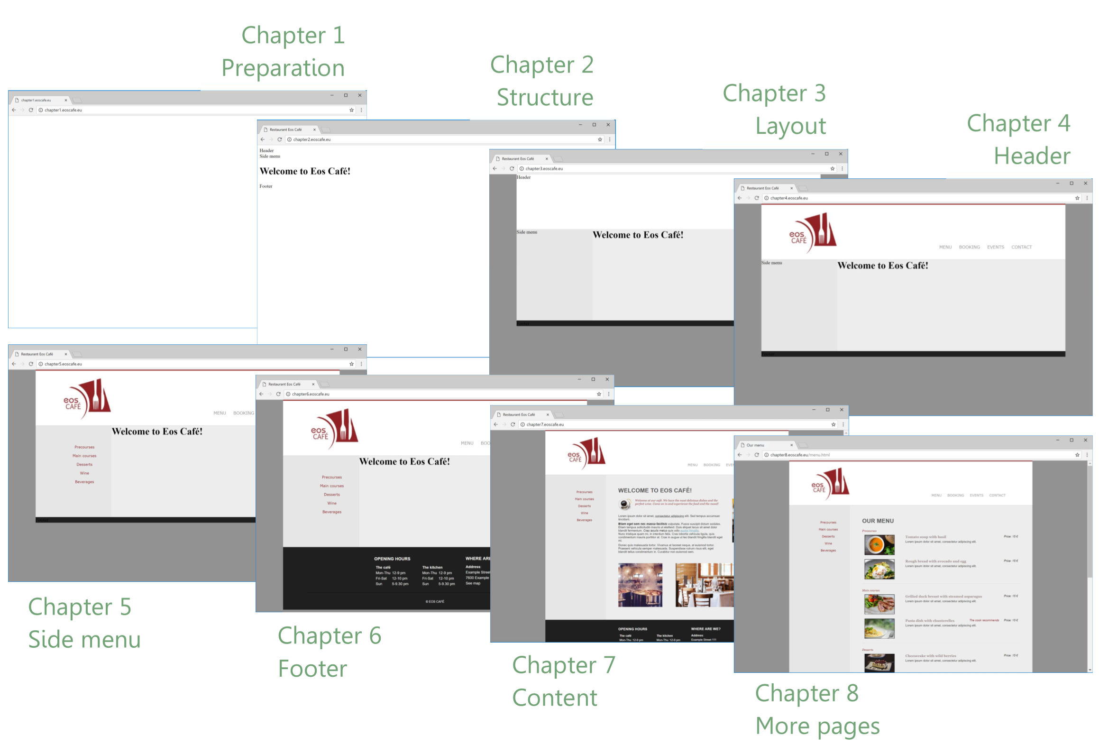
Notes:
Overview of the chapters. Illustrates where you are in the development process after finishing each chapter.

Slide 5
At www.eoscafe.eu you’ll see the final webside that will be developed
At www.htmlcss.eu/materials you’ll find graphical material along the way
Here you’ll also find the finished coding files for your own debugging
At chapter1.eoscafe.eu, chapter2.eoscafe.eu, chapter3.eoscafe.eu etc. you’ll find demos of the results as they look after each chapter
Look up the source code and use the browser’s inspection tool along the way
Notes:
Necessary resources for getting graphical material etc. and for help for debugging along the way.

Slide 6
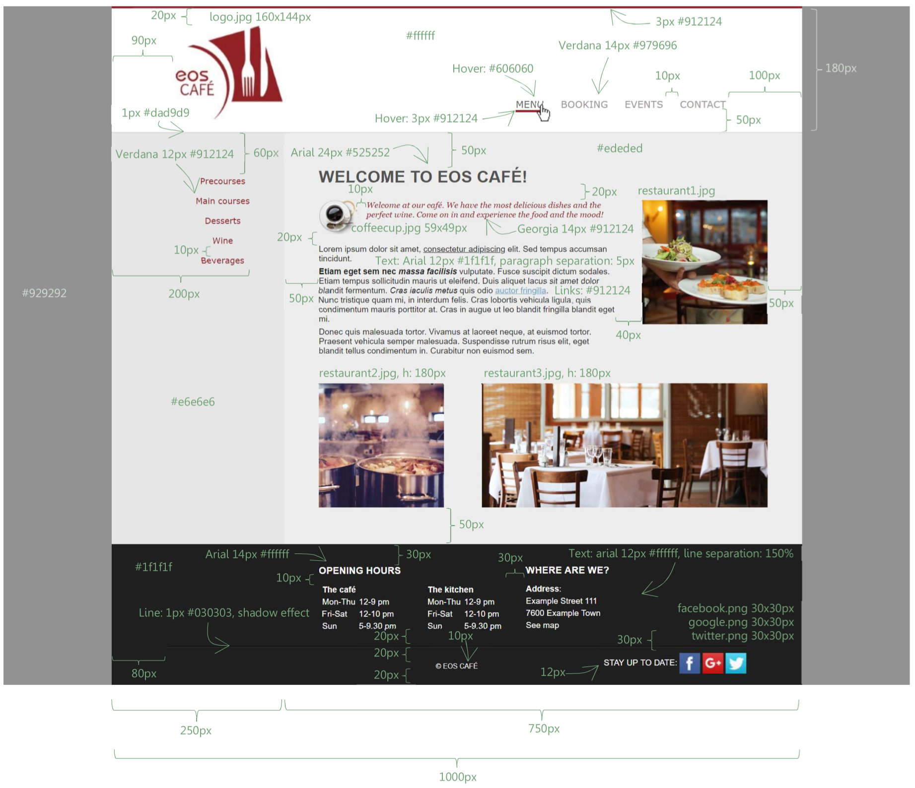
Notes:
The front page of the web design with all details for formatting, setup, sizes etc. Marked.

Slide 7
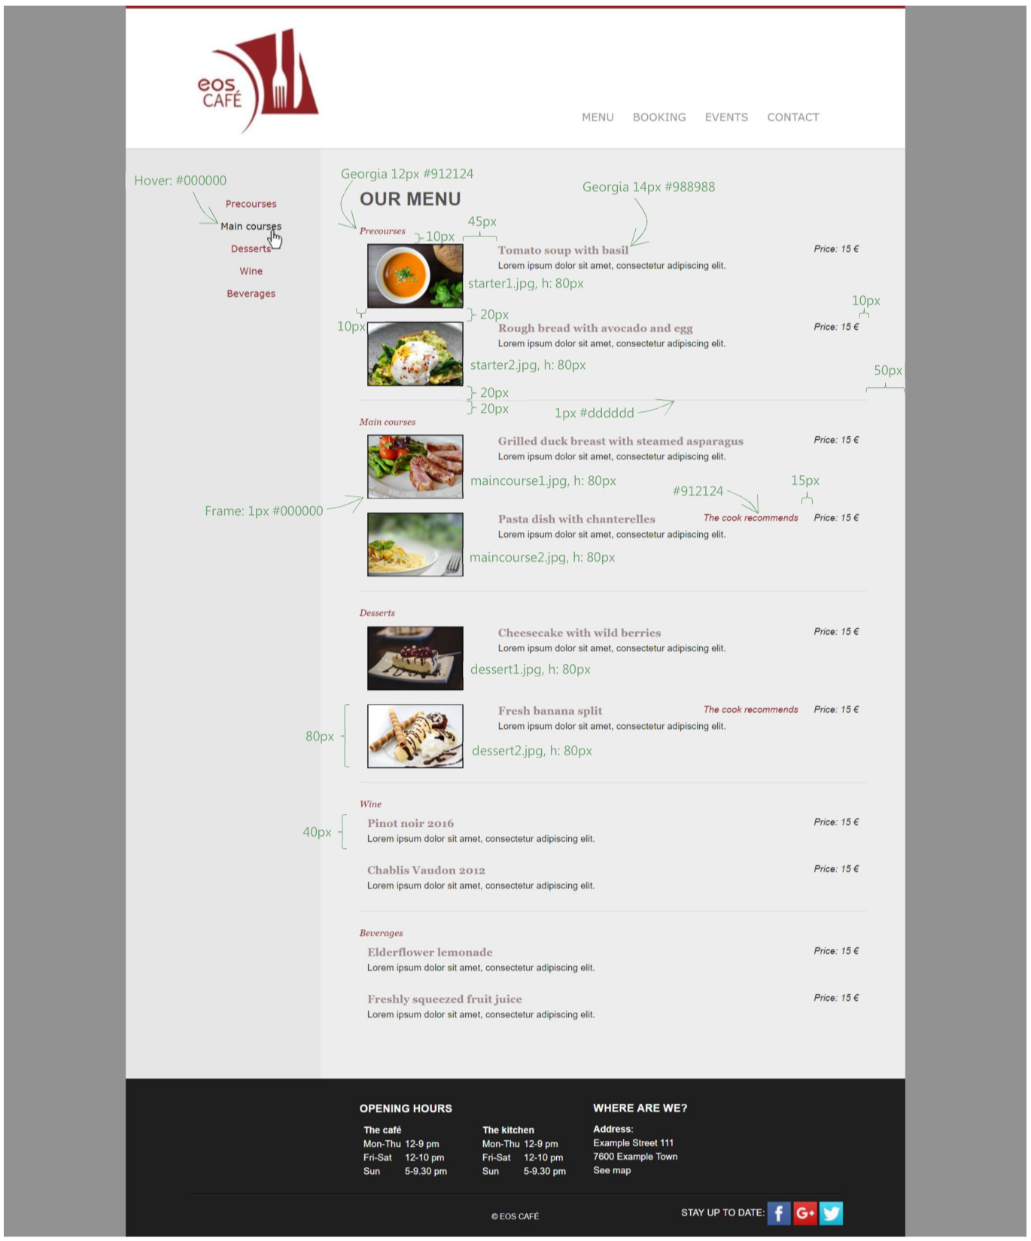
Notes:
A sub page of the website

Slide 8
Preparation
Tools and planning

Slide 9
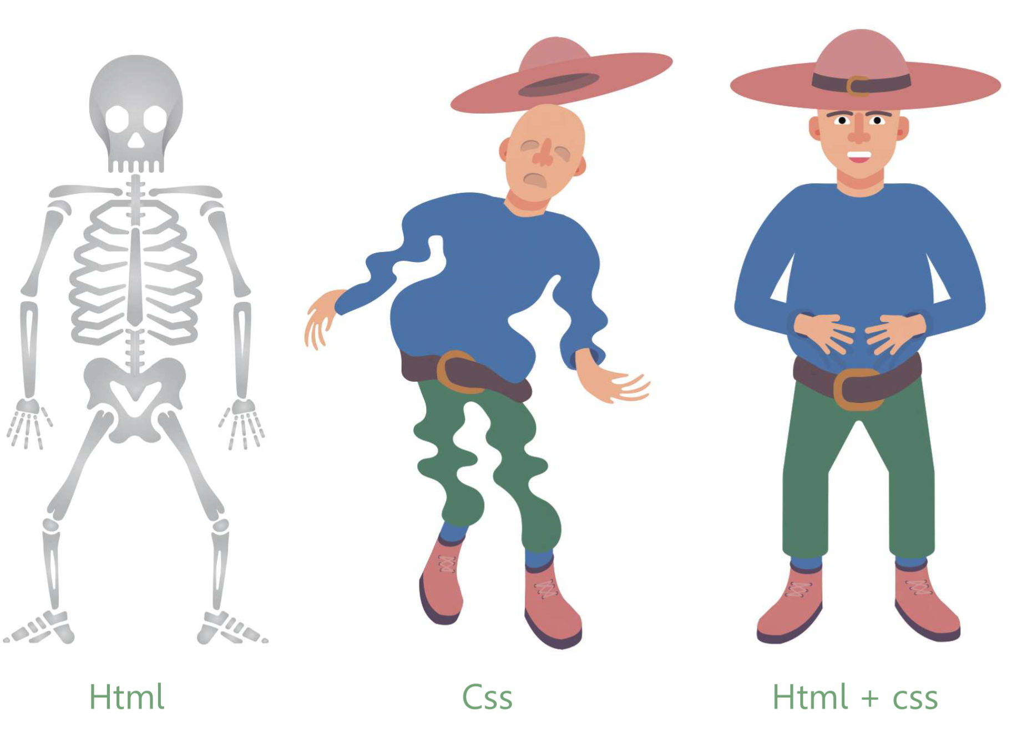
Notes:
Consider html as the skeleton and css as the shaping and colouring. Together they constitute the basic layout of any website on the internet

Slide 10


Text editor, e.g.
Browser, e.g.
Notes:
The necessary tools are simple: A text editor and a browser are everything that is needed

Slide 11
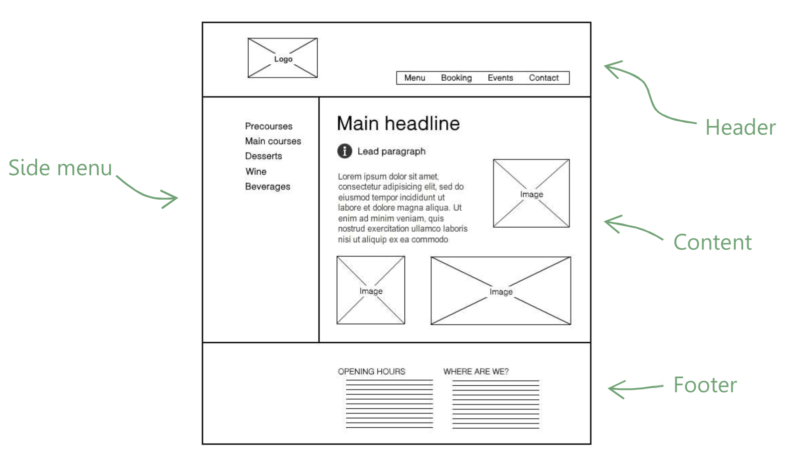
Notes:
A wireframe shows the rough outline of a single page. This rough outline is out starting point for the setup of the structure in html.

Slide 12
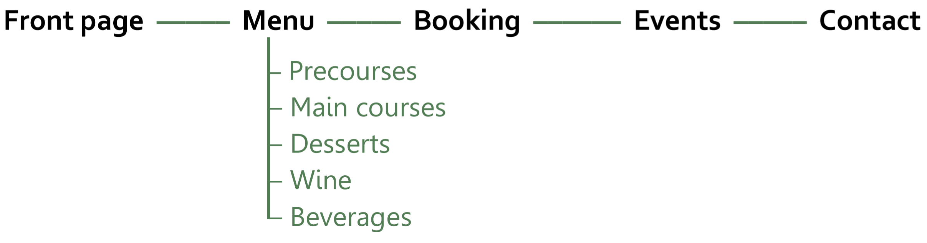
Notes:
A sitemap shows the page setup across the website. In this case we have 5 pages, and on one of these pages a listing of the restaurant’s dishes in categories. The main menu in the top of the website will link to the 5 pages, whereas the side menu will link towards the dish categories internally on the menu page.

Slide 13
Structure
Skeleton and rough setup

Slide 14
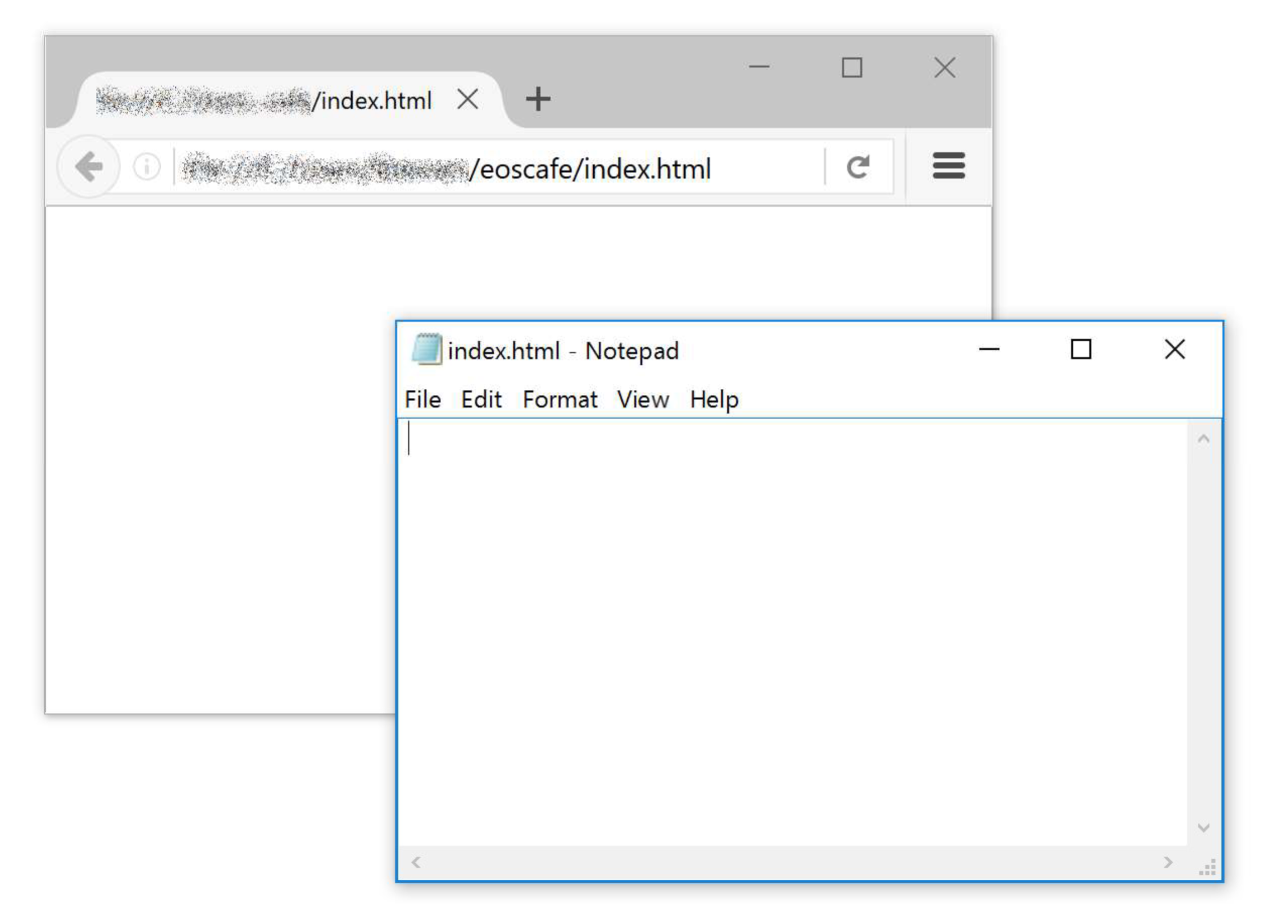

Notes:
To get started, the file system is set up. Create a folder, for example named ”eoscafe”, anywhere on your pc and create a new text document therein. Rename the document to ”index.html”. Be sure to change the file extension from .txt to .html. Keep this file open in both your text editor and browser.

Slide 15
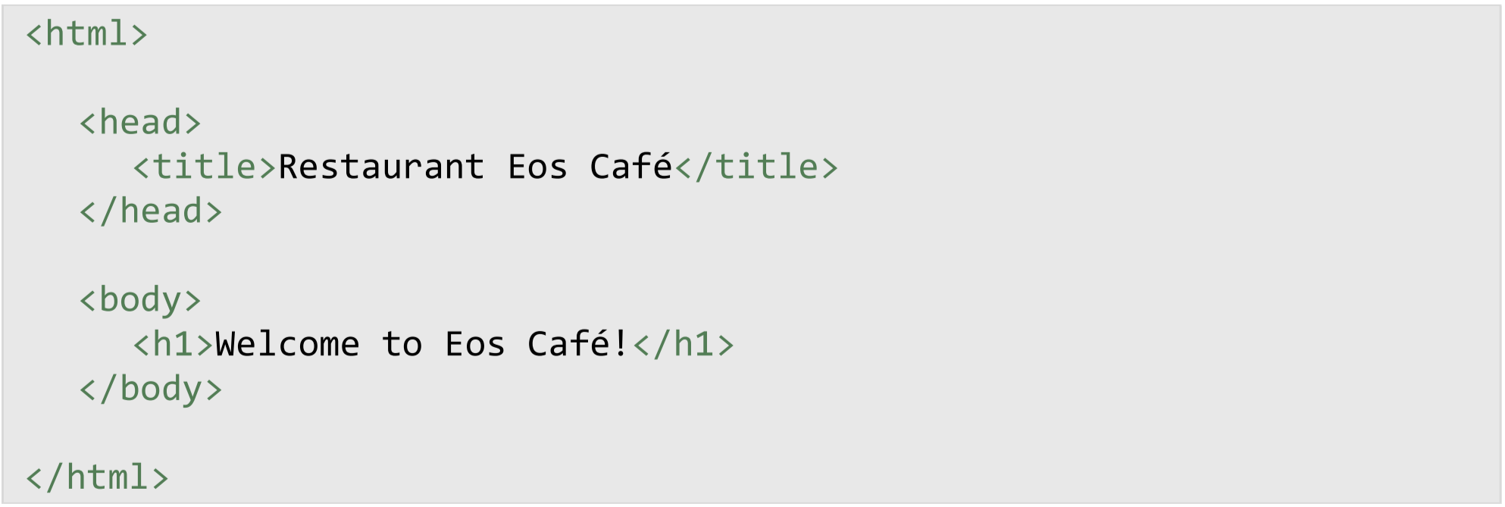
Notes:
The first codes.

Slide 16
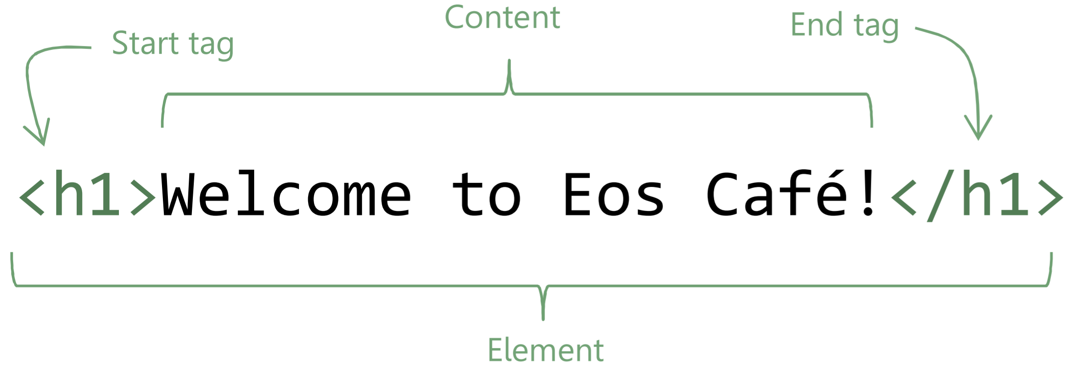
Notes:
The structure of html with its elements, consisting of start tags and end tags.

Slide 17
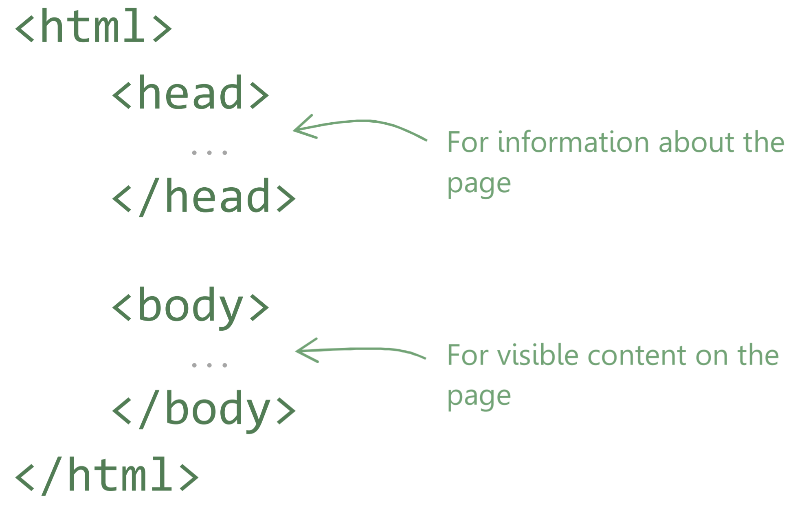
Notes:
The html structure in an html file. Where which type of element is to be placed.

Slide 18
Lecture 2: Layout
Shapes and colours

Slide 19
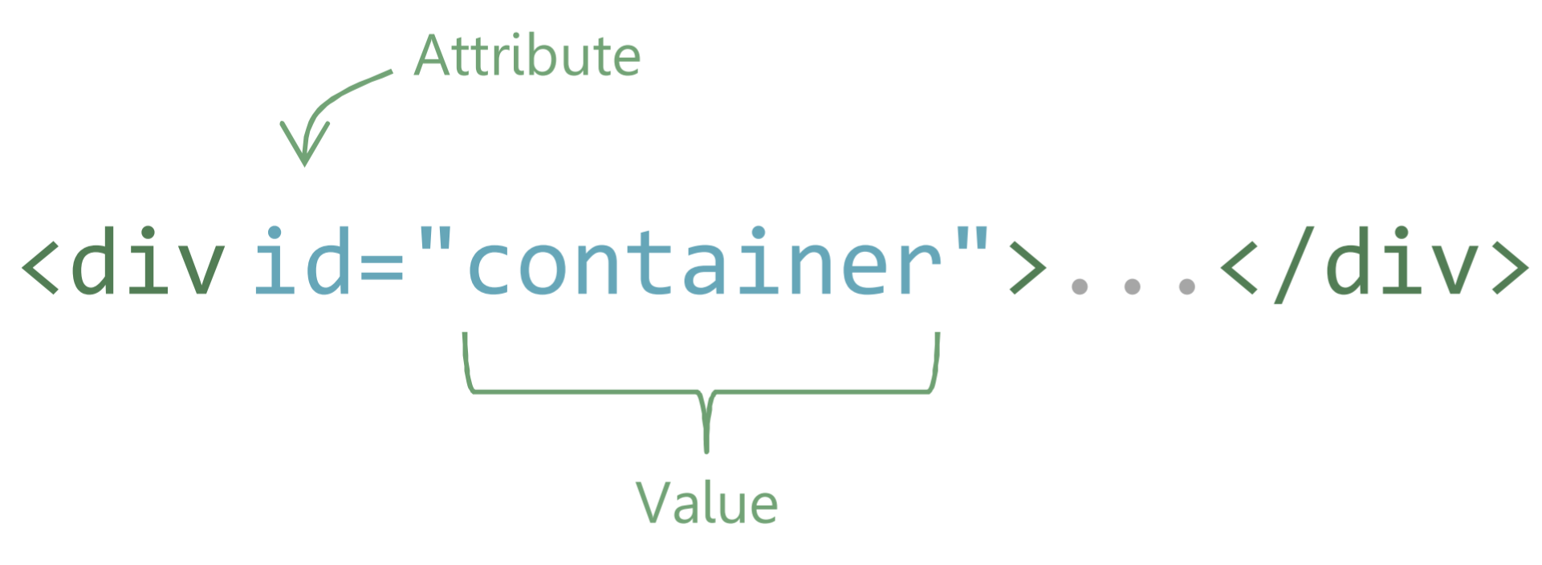
Notes:
Recap. Elements, tags and attributes

Slide 20
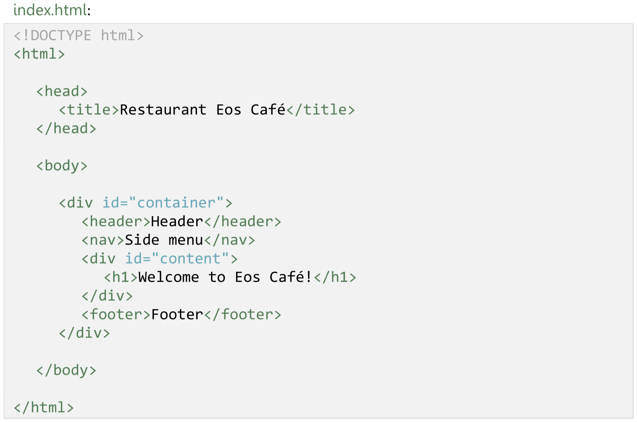
Notes:
Recap. The code as it ought to look before we start chapter 3.

Slide 21
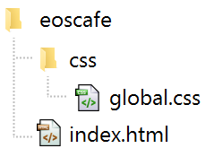
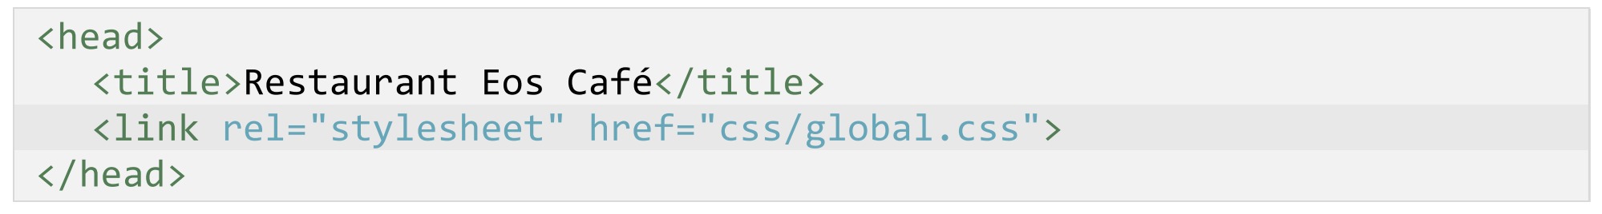
Notes:
Create a new file named ”global.css” (remember to remove the default extension) in a new folder named ”css”. Write a <link> element in the html file to create a connection to the new css file.

Slide 22
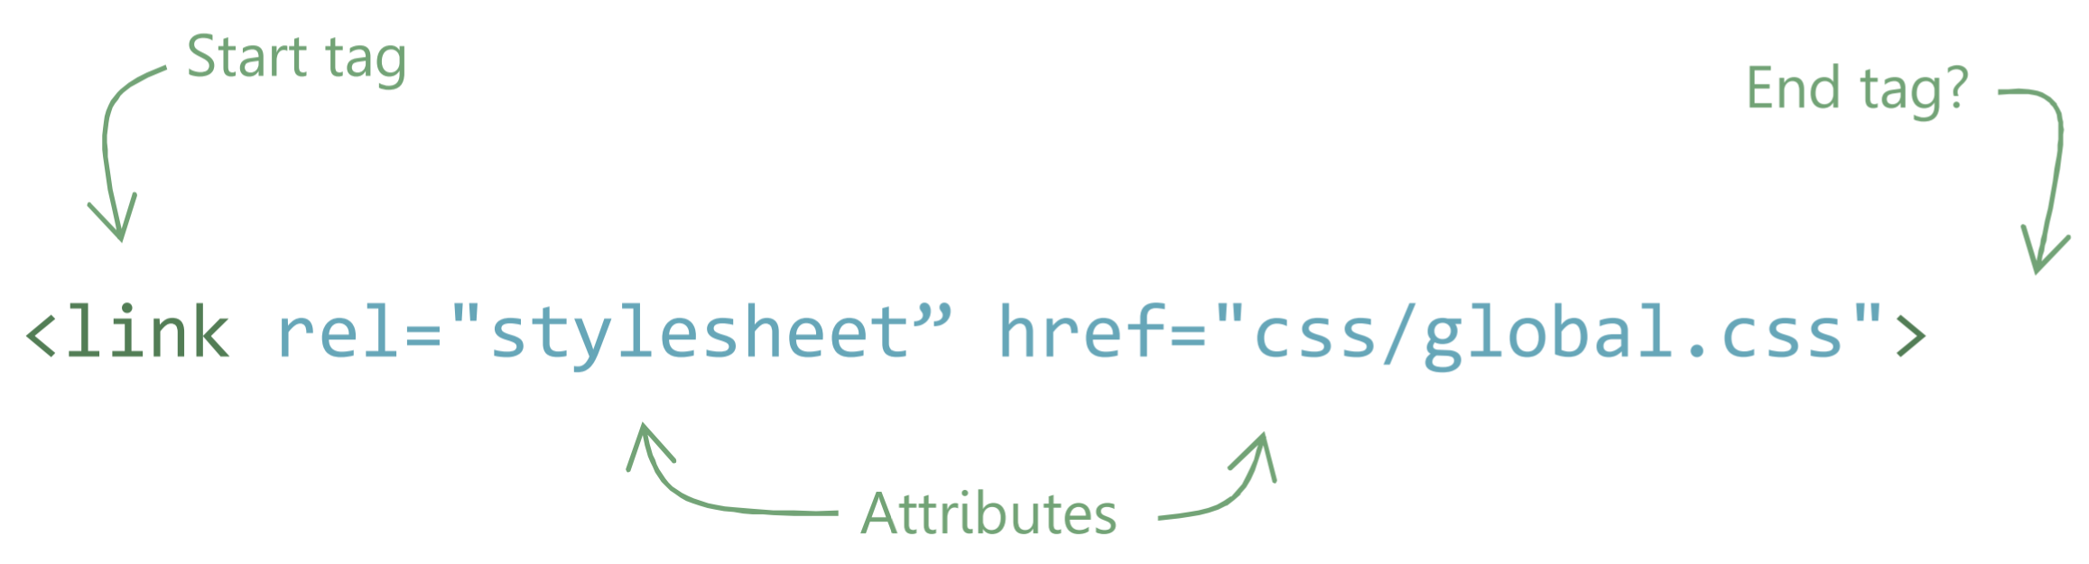

Notes:
Not all elements can contain content. Also so-called void elements with an end tag exist.

Slide 23
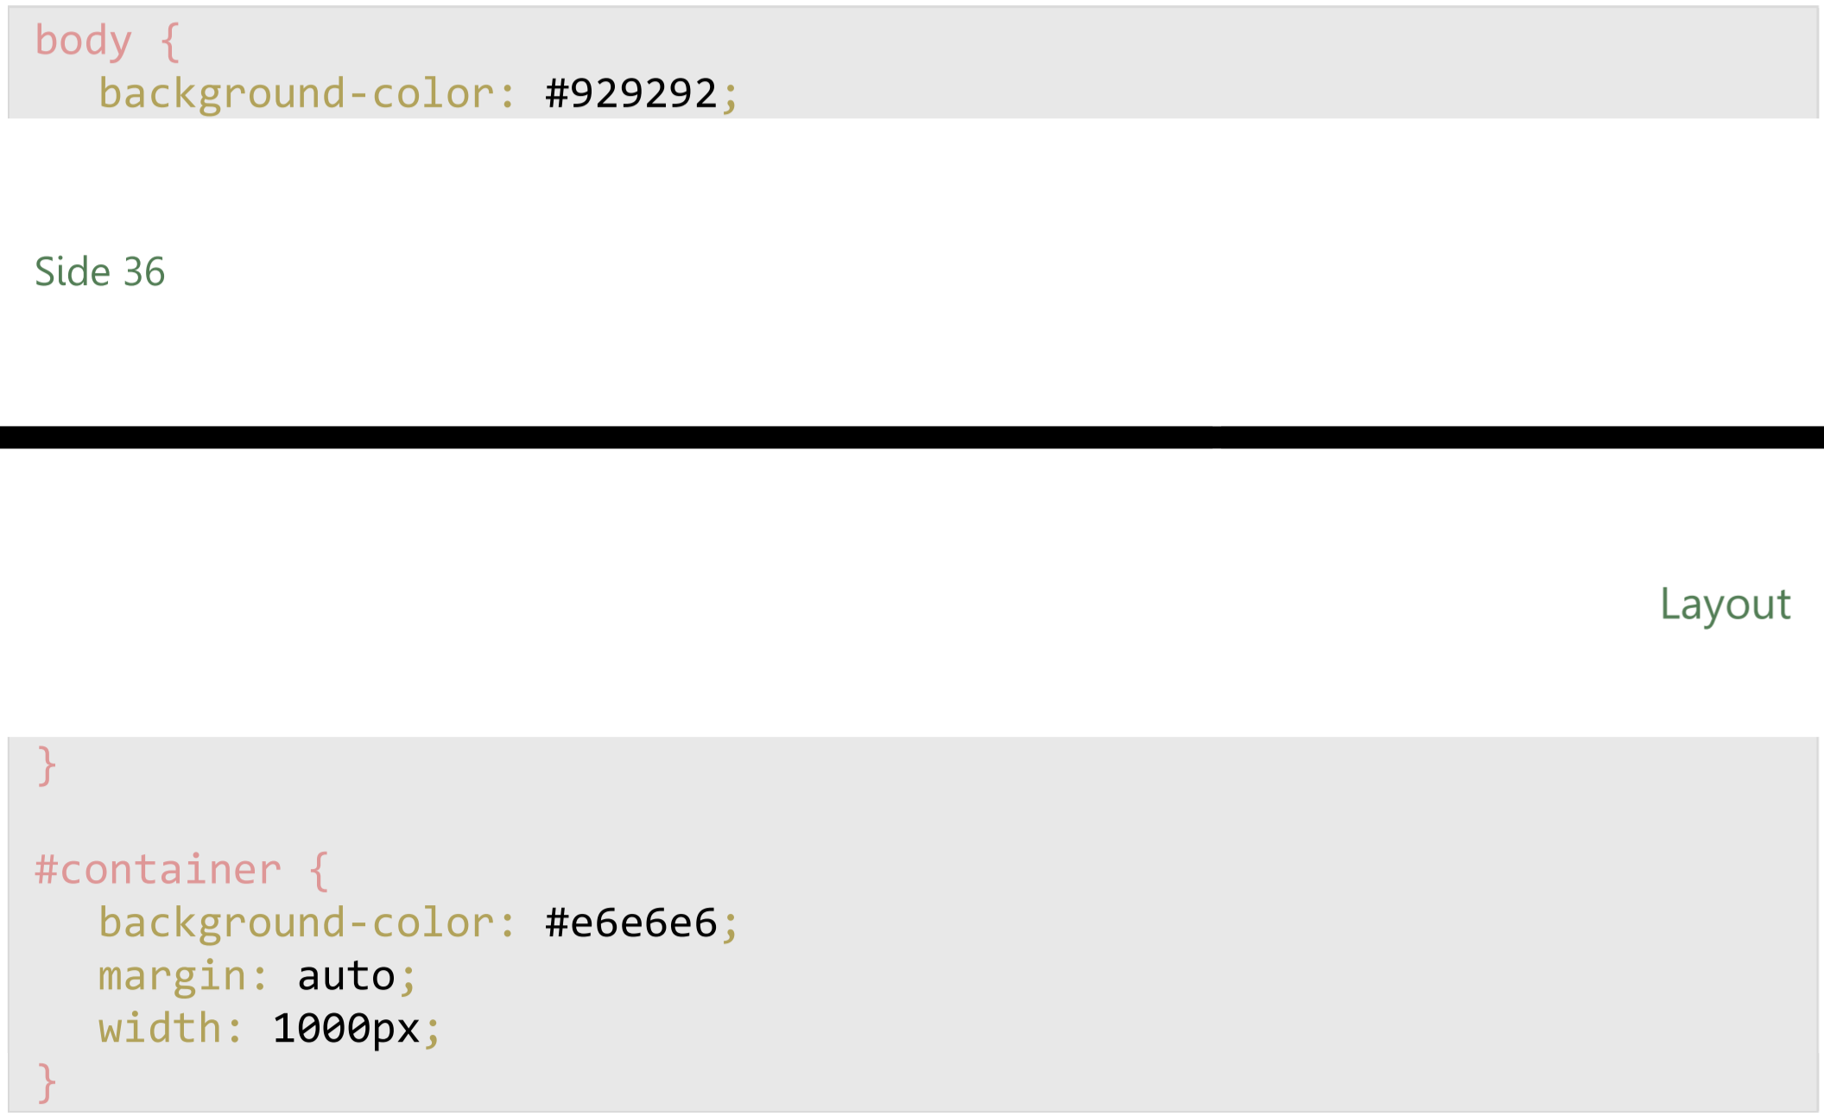
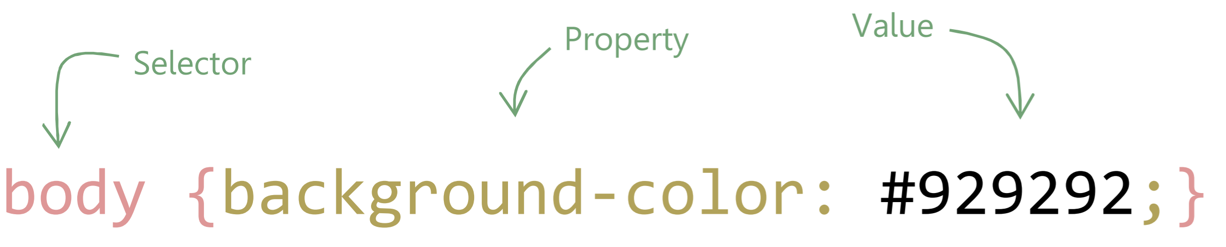
Notes:
The first css codes. Css consists of selectors with a set of properties that contain one or more values.

Slide 24
The box model and floating boxes

Slide 25
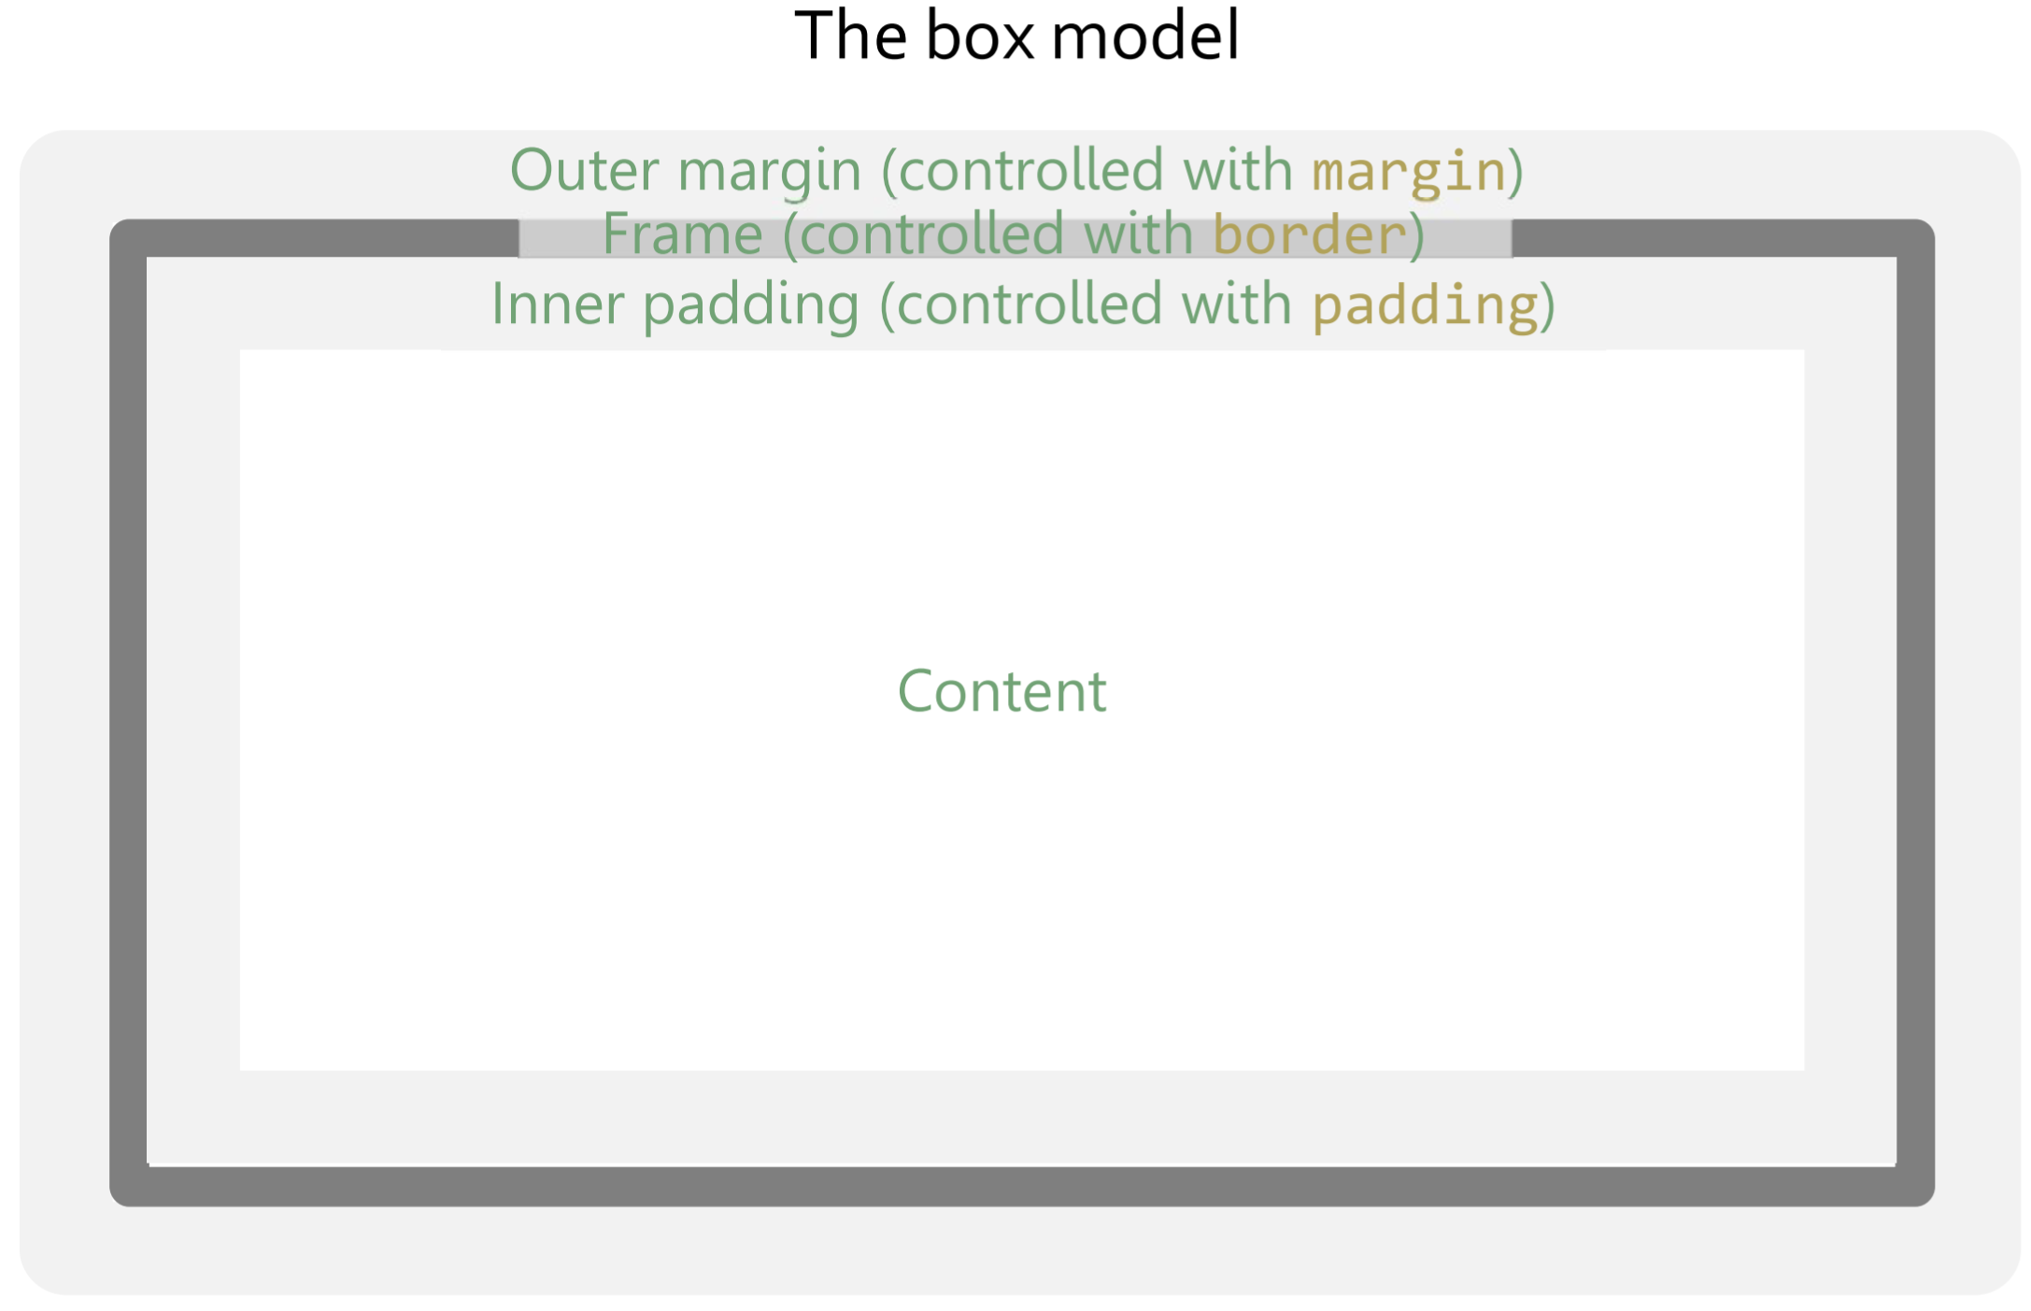
Notes:
The box model define how sizes are added up. The space for the content set with ”width” and ”height” must be added to the border thickness as well as any ”padding”, before we have the size of the box. The box is thus larger than the set ”width” and ”height”. Margin is not adding to the box size.

Slide 26
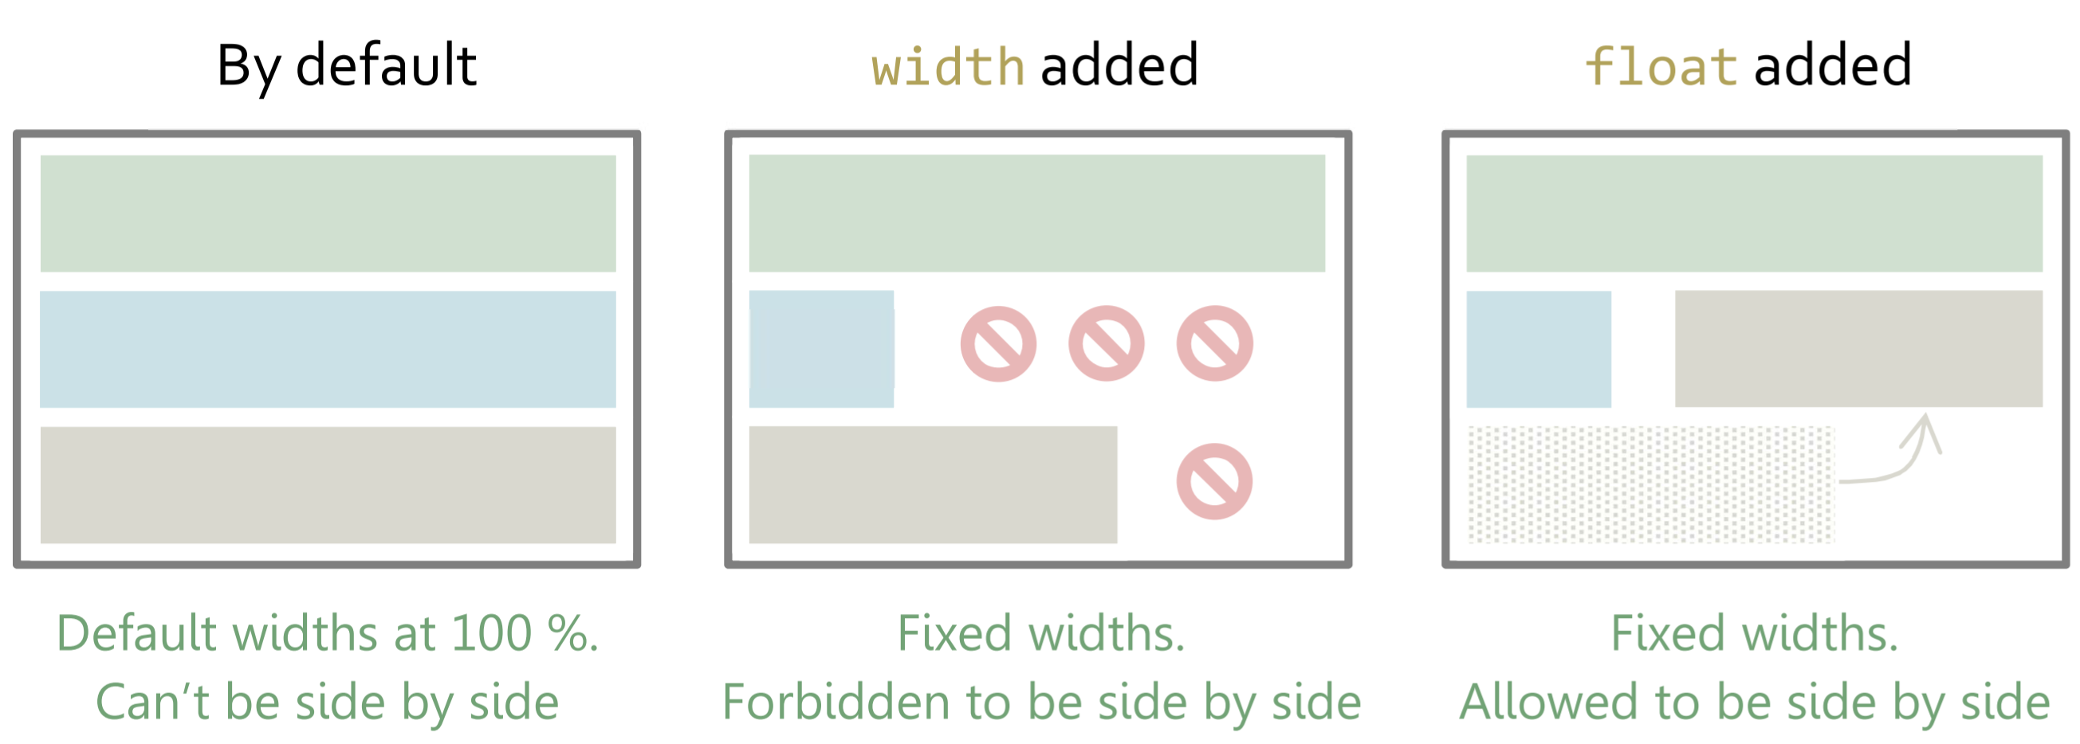
Notes:
Floating boxes with the ”float” property controls positioning of box elements.

Slide 27
Lecture 3: Header
Images and links

Slide 28
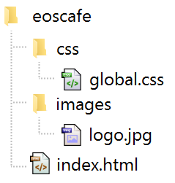
Get the logo.jpg at www.htmlcss.eu/materials .
Notes:
The images are to be added. Pick up graphical materials on the website’s resource page. The teacher should click and show the page. Then an ”images” folder is to be created, in which the image is to be placed.

Slide 29
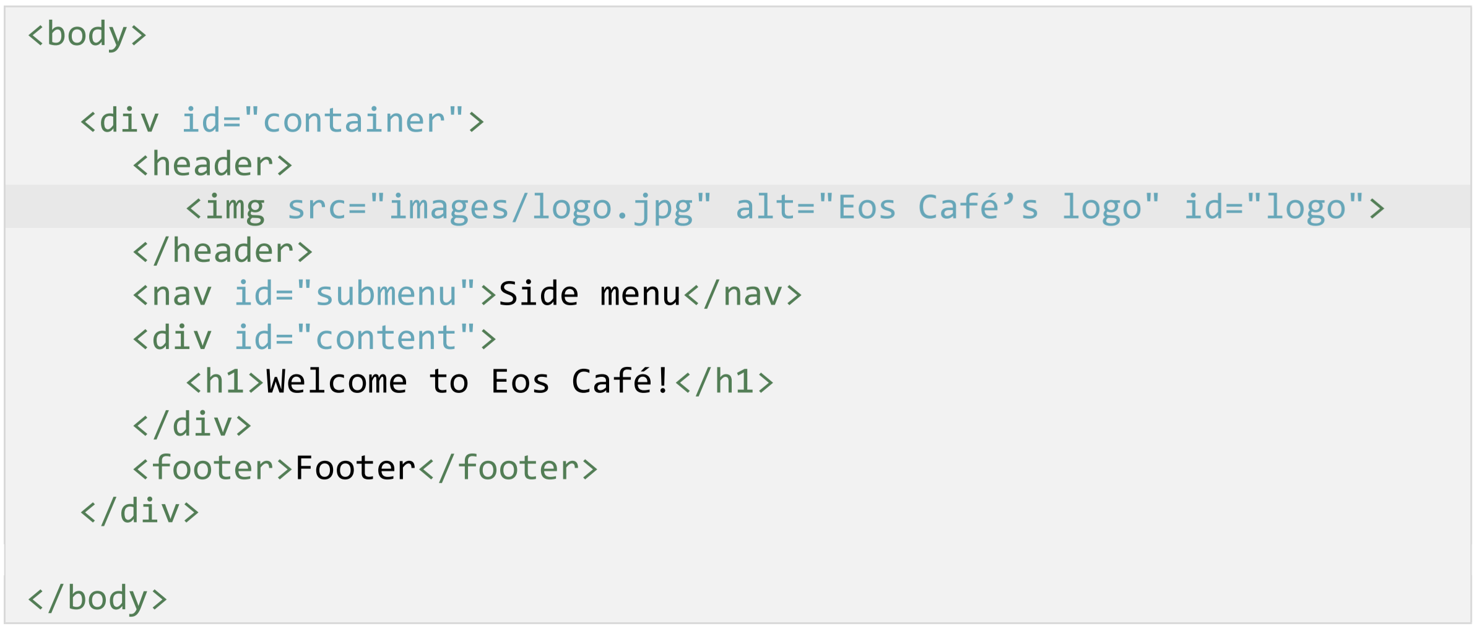
Notes:
The <img> element is added to the html code with several attributes. Relative vs absolute paths can be discussed here.

Slide 30
Multiple values in one property

Slide 31
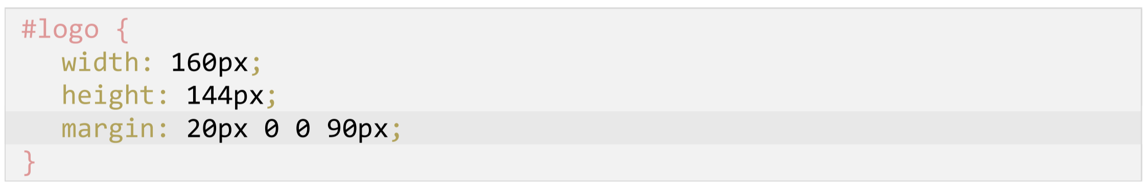
Notes:
This code block is written during the chapter. It shows that several values can be added into one property in certain cases.

Slide 32
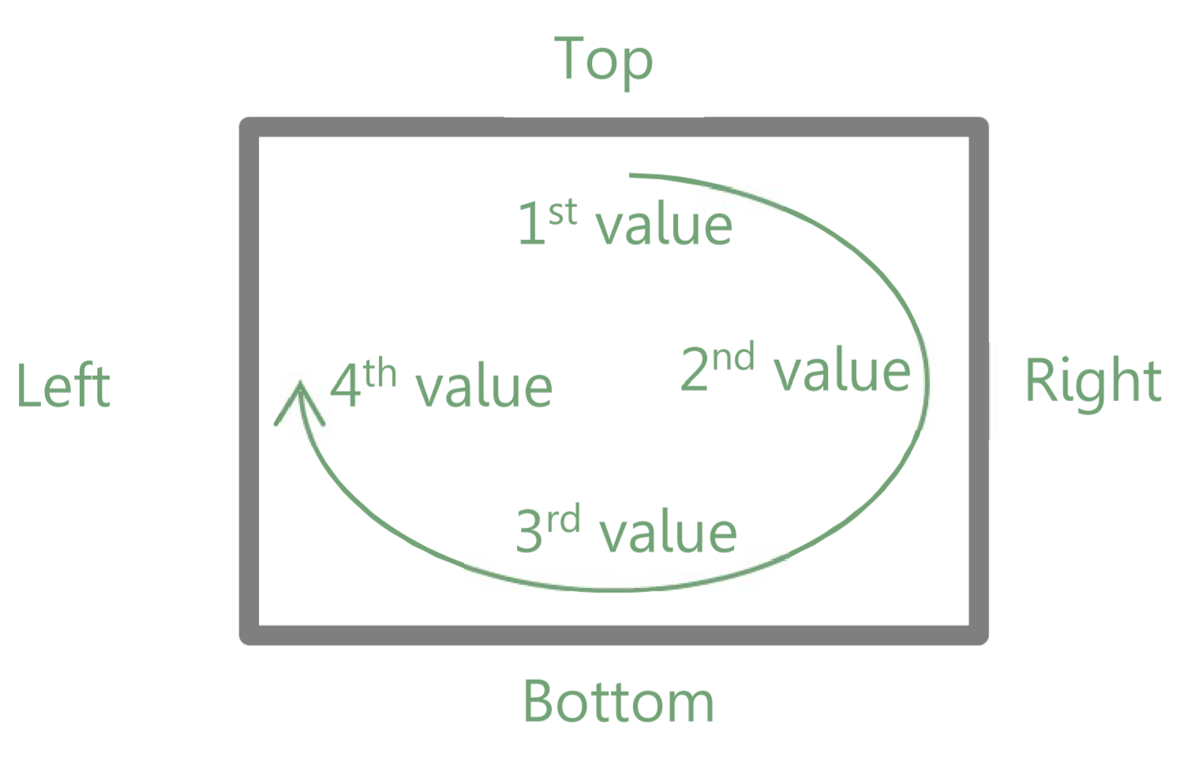
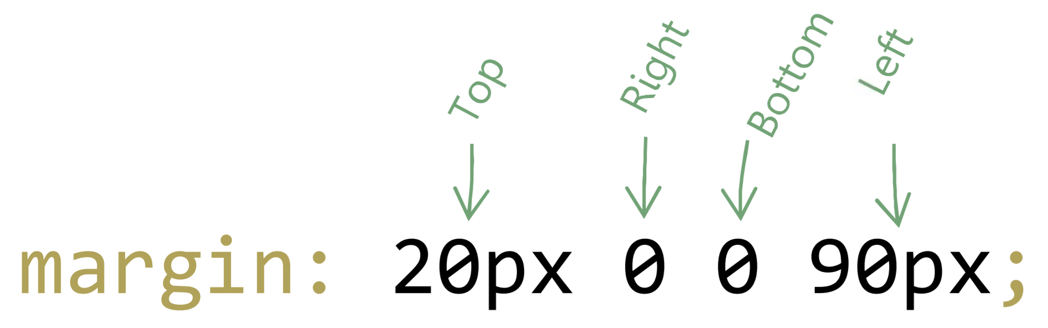
Notes:
The four values represent the value towards each side as read clockwise around the box.

Slide 33
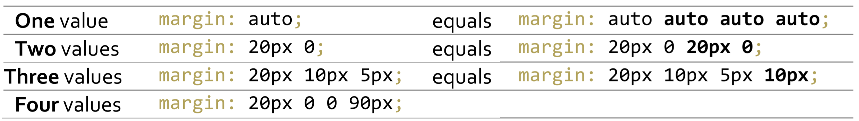
Notes:
The different possibilities of multiple number values in a property.

Slide 34
Positioning

Slide 35
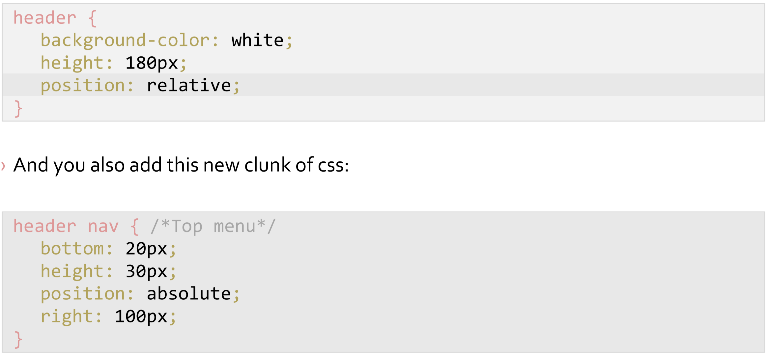
Notes:
These code blocks are written during this chapter. A block can be positioned according to the edge of a box with ”coordinates” by using the ”position” property.

Slide 36
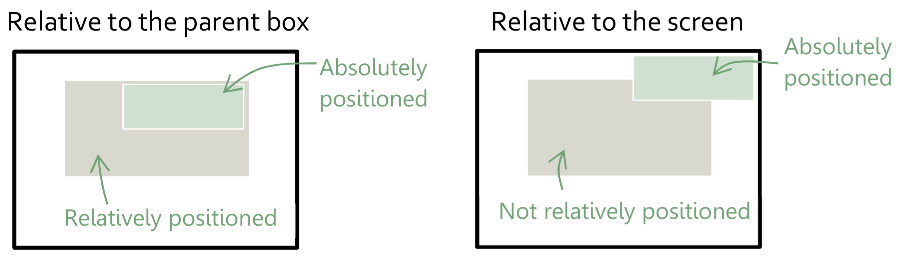
Notes:
An absolutely placed box loses its entire ”filling” on the page and is placed on the page as a sticker, so to say. ”bottom” and ”top” (and equivalent) position the box as coordinates. Those coordinates define the distances to the surrounding reference. By default, this reference is the screen edges (browser window edges). To have the box positioning itself absolutely according to the surrounding box rather than the screen, we can add a ”position: relative” (or other ”position” value) on that surrounding box.

Slide 37
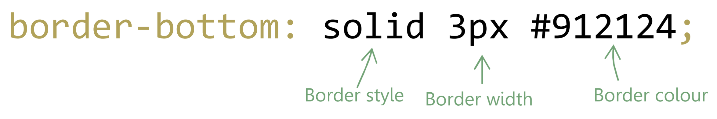
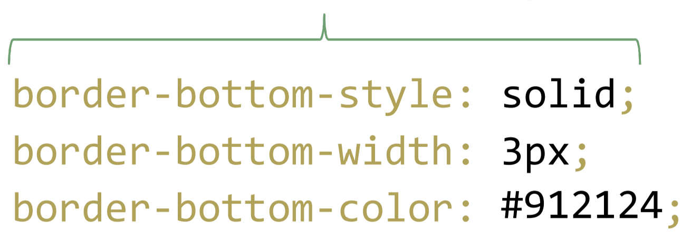
Notes:
In this chapter these lines are written. They collect, not just several values, but several *different types* of values in one property. These collected values can also be set individually.

Slide 38
Lecture 4: Side menu
Lists and margin control

Slide 39
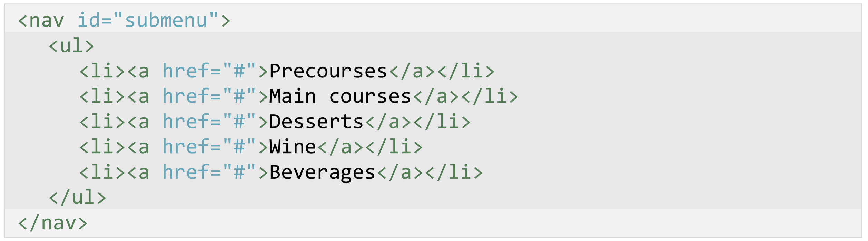
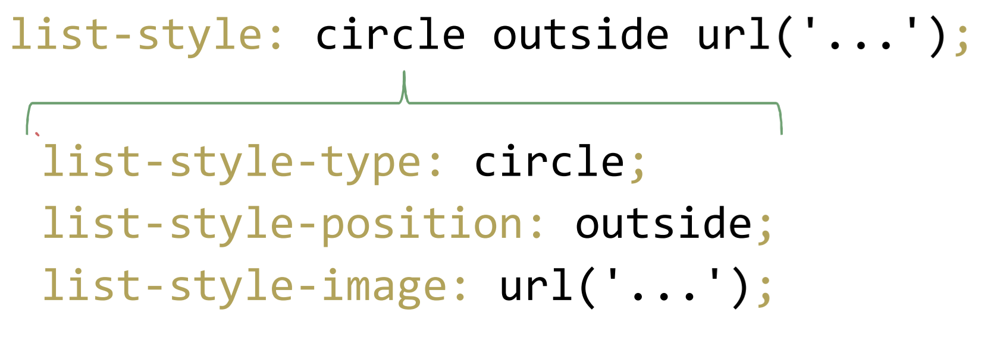
Notes:
Lists in html consist of the elements <ul> (or correspondingly <ol> for a numbered list) and <li>. For lists, we have several specific properties to work with, such as the shown examples.

Slide 40
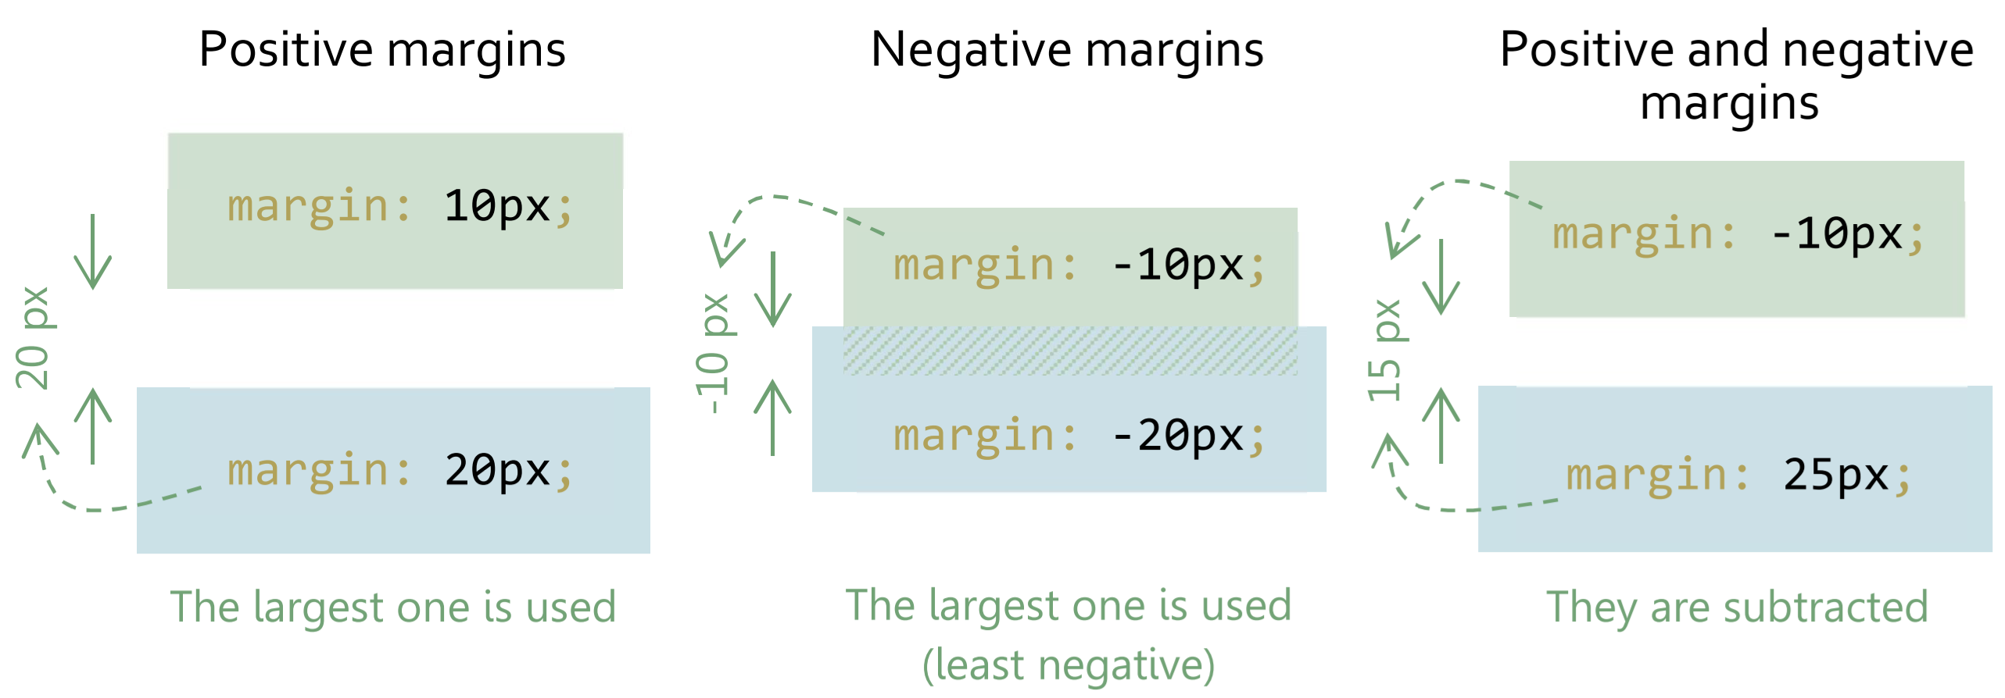
Notes:
Collapsing margins. When vertical margins meet, as they often do in regards to list elements, a perculiar phenomenon happens, where their vertical (top and bottom) margins are *not* simply added together as you would have expected. Rather, one is collapsed and ignored, depending on the value.

Slide 41
Lektion 5: Footer, part 1
Tables

Slide 42
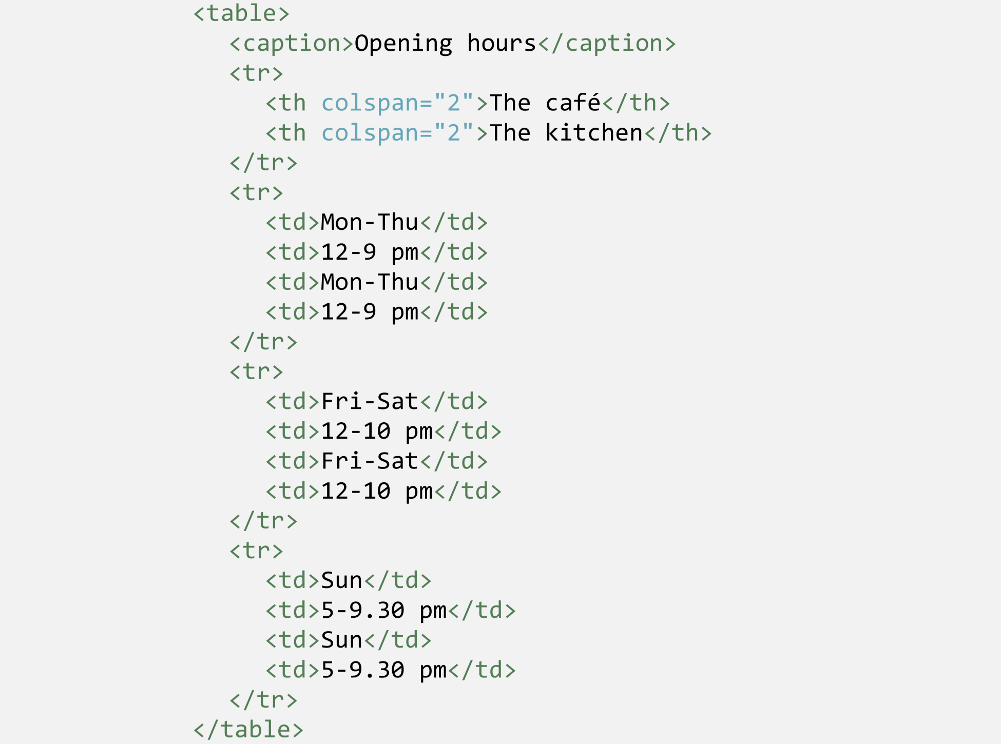
Notes:
Tables are created in this chapter. A table consists of row elements <tr> with cell elements <td> and possibly <th> cell heading elements, all wrapped inside a <table>, possibly along with a <caption> element. The attributes ”colspan” and ”rowspan” can merge cells. Note the table structure: While we code ”vertically”, so to say, all <td> are cells that will be shown horizontally side-by-side. Tables quickly become large in their code and you may lose the overview now and then. So, be careful and don’t forget an end tag.

Slide 43
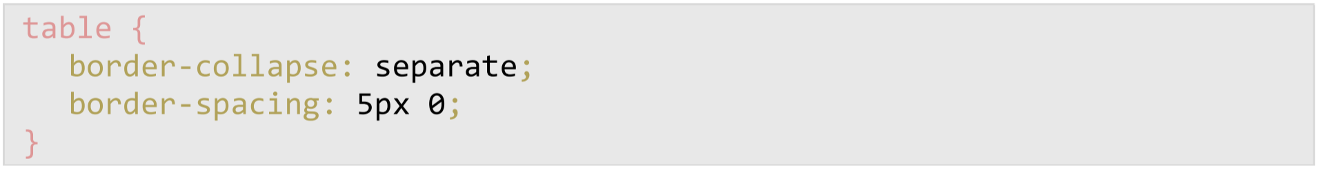
Notes:
The spaces between cells in a table can be controlled with the shown properties. While ”border-collapse” controls if there is space or not (if the edges of neighbour cells ”merge” into one or not), the ”border-spacing” property controls the size of the space horizontally and vertically, respectively.

Slide 44
The pseudo-class
:nth-child(…)

Slide 45
Notes:
The pseudo-class ”:nth-child(…)” was written in this section. It ”counts” the child elements and reaches a specific element depending on its position in the hierarchy.

Slide 46
:nth-child(1)
:first-child
:nth-last-child(1)
:last-child
Notes:
Several ”child” selectors exist. The shown ones here are pairwise reaching the same element.

Slide 47
Reaches every even-numbered table row:
tr:nth-child(2n)
Reaches every odd-numbered table row:
tr:nth-child(2n-1)
Notes:
The variable ”n” can be used in the ”:nth-child” selector as a mathematical variable that runs through all integers.

Slide 48
Lektion 6: Footer, part 2
Entities

Slide 49
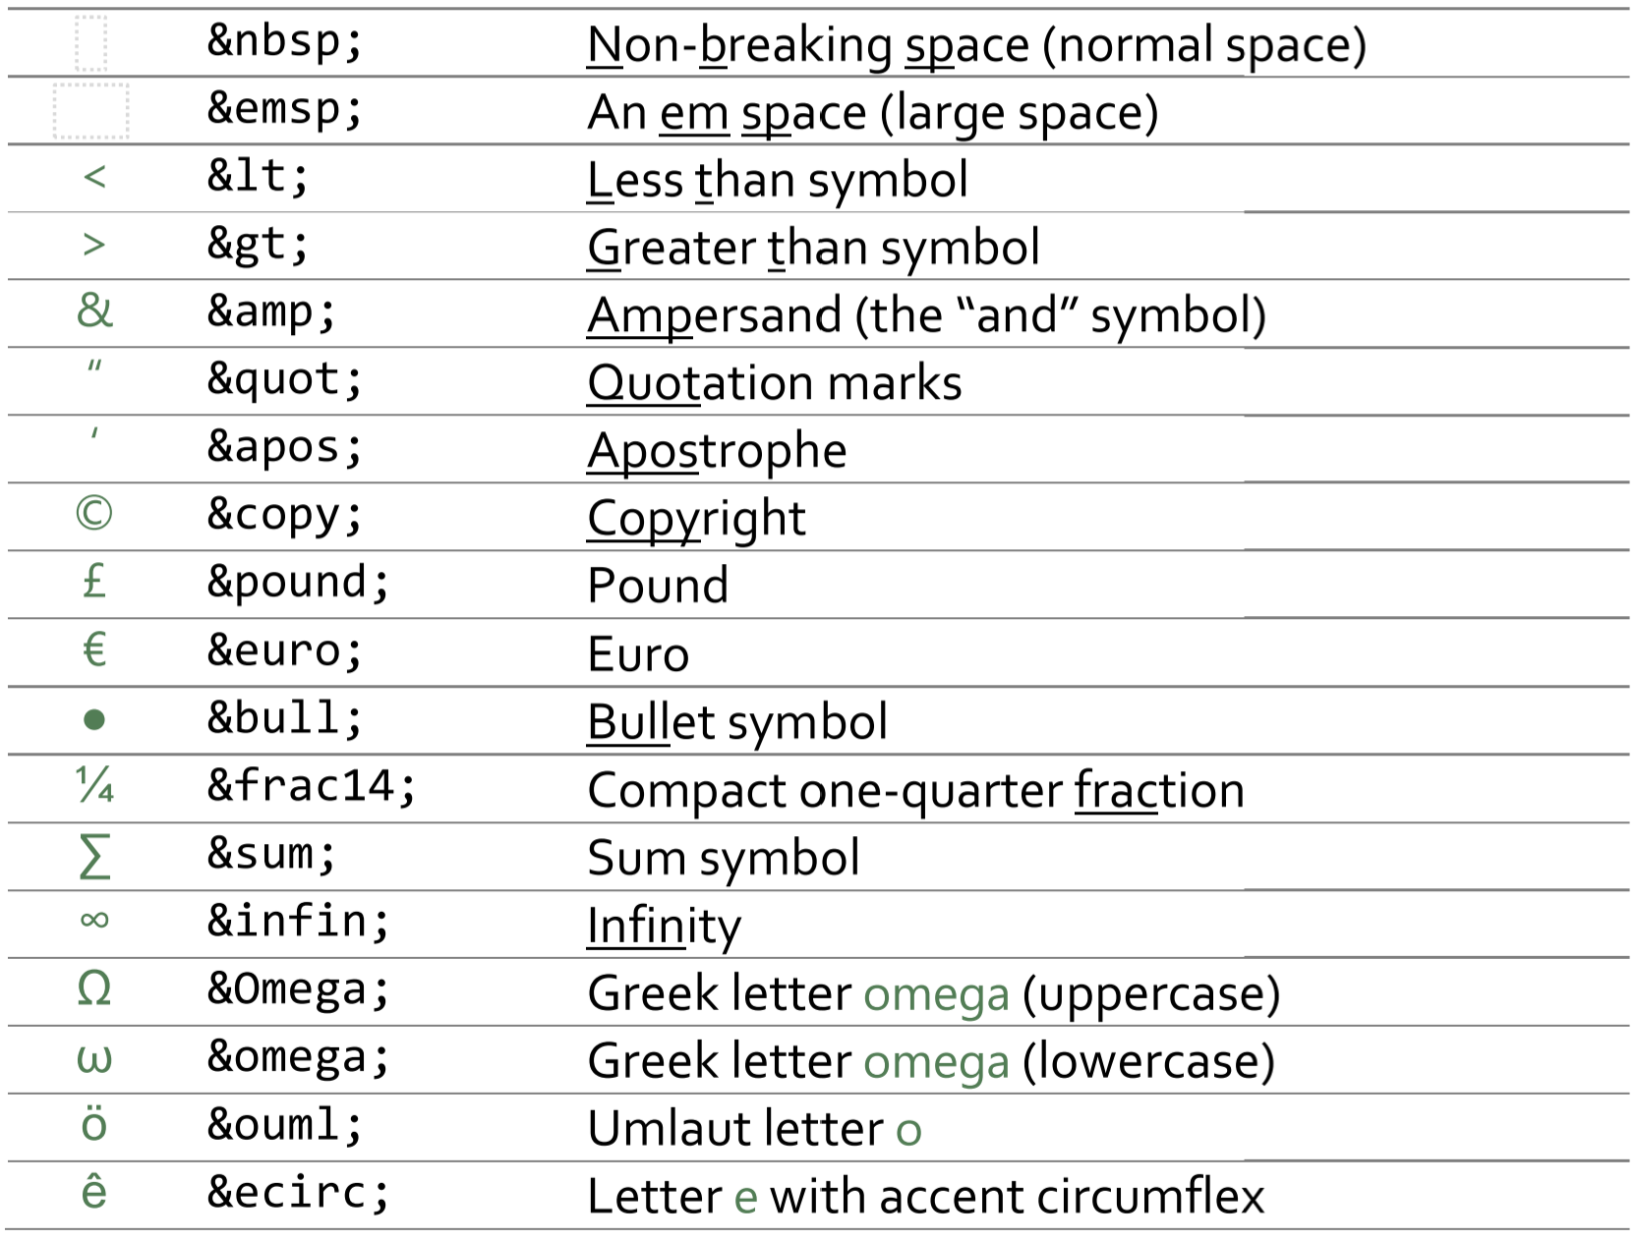
Notes:
An entity is used when you either are not allowed to use a particlar character (such as code-technical and reserved characters like ”>” and ”&”) or when you don’t have access for the character or symbol on your keyboard (such as Greek letters and mathematical symbols).

Slide 50
Family hierarchies

Slide 51
Parent
Box in question
Child
Descendant
Descendant
Descendant
Sibling
Sibling
Ascendant
Ascendant
Ascendant
Notes:
The idea of family hierarchies exist in order to enable us to talk about specific boxes in our nested box structure with boxes inside boxes. A specific box has a parent, which it is placed inside, and maybe children, which are inside of it. There might also be boxes inside those children, called descendants, or boxes wrapping around the parent box, called ancestors. Finally, a box may also have sibling boxes.

Slide 52
All following siblings: div ~ a
The first-following sibling: div + a
Children: div > a
Descendants: div a
Parent: Impossible in css
Ancestors: Impossible in css
Notes:
These selectors are examples of how to reach around in the family hierarchy. It is not possible with css to reach upwards in the hierarchy to parents or other ancestors.

Slide 53
Lecture 7: Content box
Work with text

Slide 54
Text colour: color
Font type: font-family
Font size: font-size
Boldness: font-weight <b>
Italic: font-style <i>
Capitalisation: text-transform
Under/overlining: text-decoration <u> <s>
Notes:
These are the properties so far that regard text formatting. Certain formatting *elements* also exist.

Slide 55
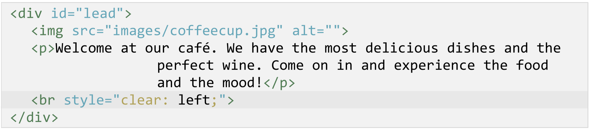
Notes:
In this chapter the ”style” attributes is used. It adds css to the html *inline*. Correspondingly, *external* css exists via an external css file as we have used so far in this book, as well as *internal* css that is written directly in the <head> part of the page.

Slide 56
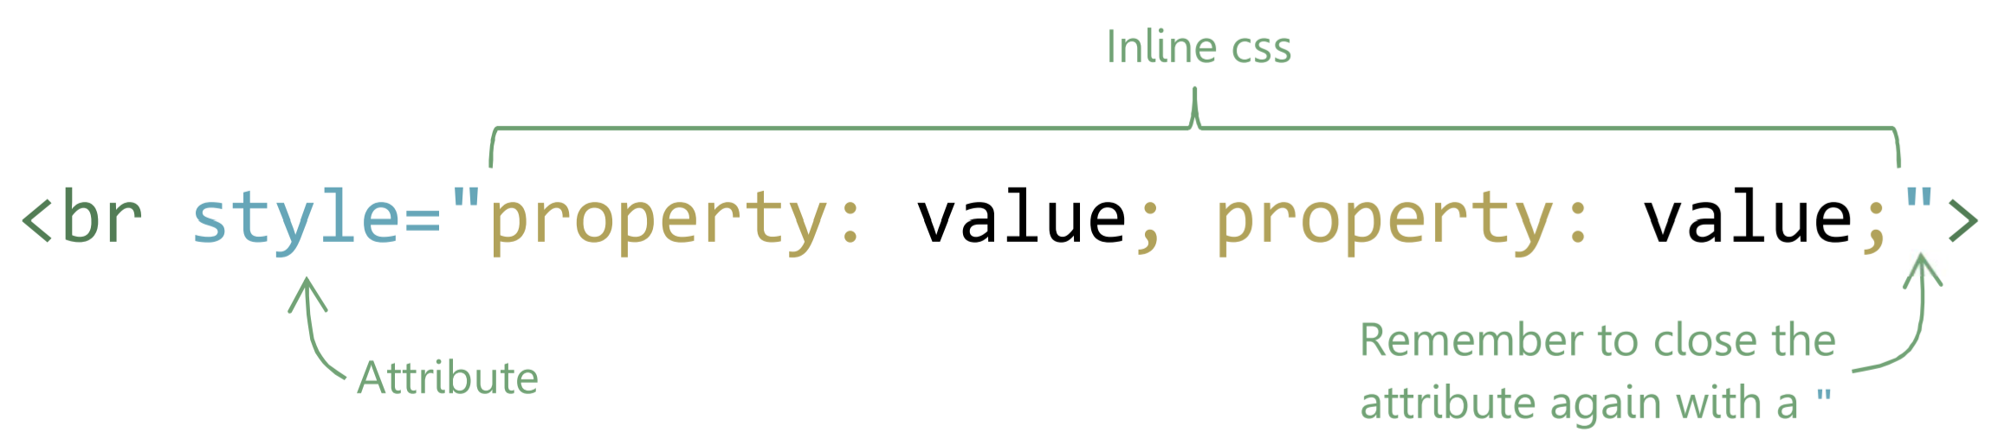
Notes:
Inline css is written directly in the ”style” attribute with all properties on one line. Selectors are not used since this reaches this partilar line only.

Slide 57
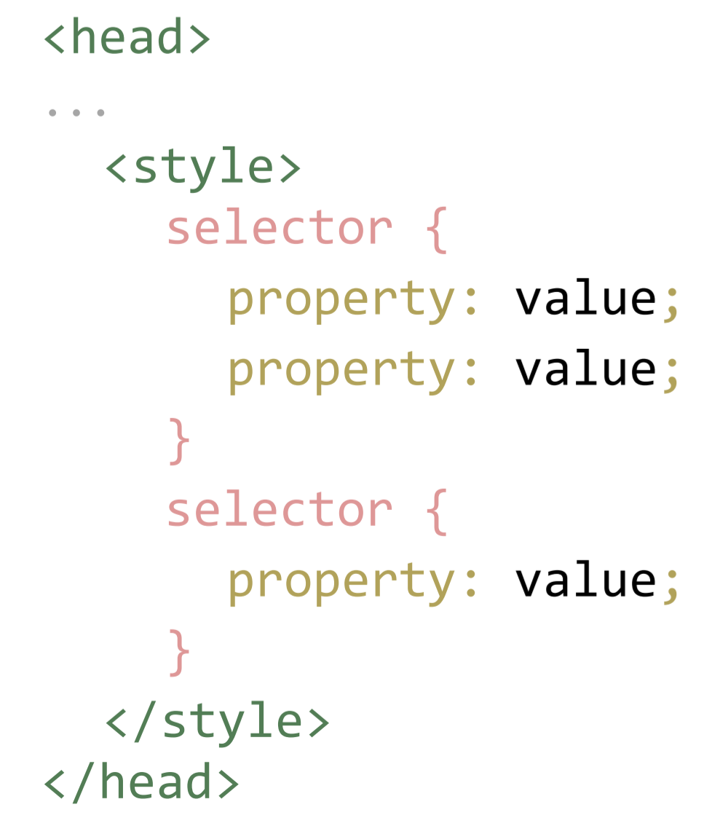
Notes:
Internal css is written in the <head> part of the page. The internal css is written just like in the css file including selectors, but inertnal css of course only reaches elements within this particular html file.

Slide 58
Property overlap is resolved via the selector’s specificity.
See htmlcss.eu/specificity.
One trump exists:
selector {property: value !important;}
Notes:
Css specificity decides the prioritisation among properties that overlap, in order to determine which property that should prevail and be shown. Specificity can be trumped by ”!important”.

Slide 59
Lektion 8: Flere sider

Slide 60
Notes:
Another look at the sitemap. The link structure in the navigation menues on the page are about to be created.

Slide 61
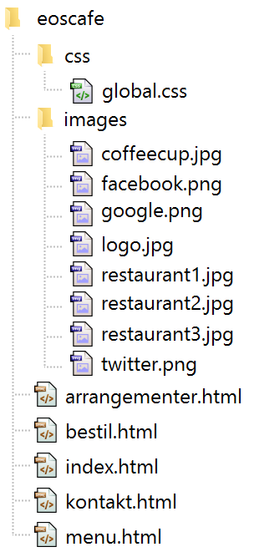
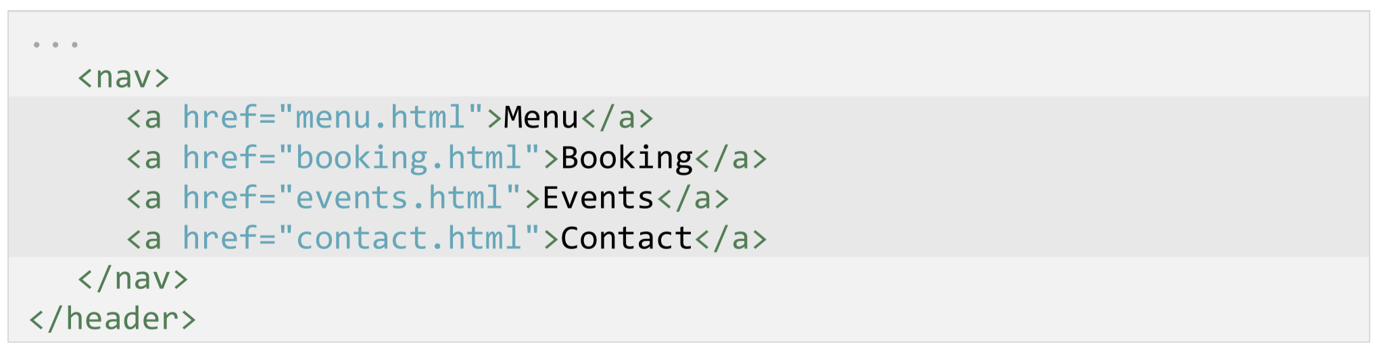
Notes:
The top menu will look like this with added link paths towards the other pages that are about to be created as new html-files. These files can be created simply by copy/pasting the existing index.html file and edit the file name and content to match the new file.

Slide 62
Bookmarks

Slide 63
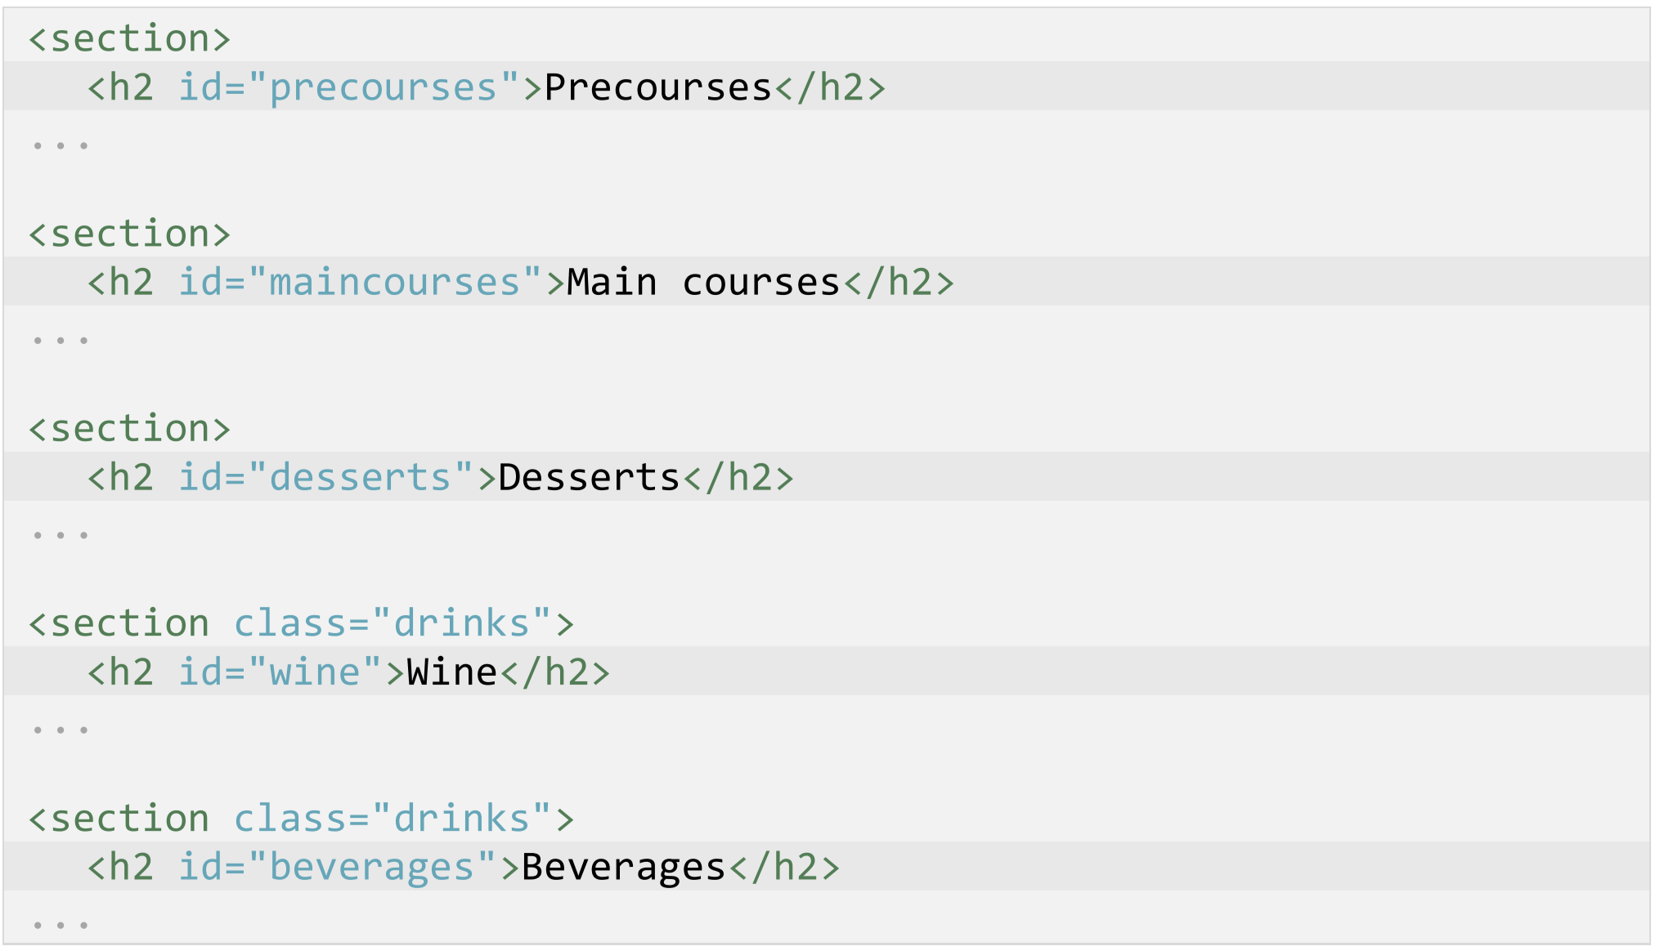
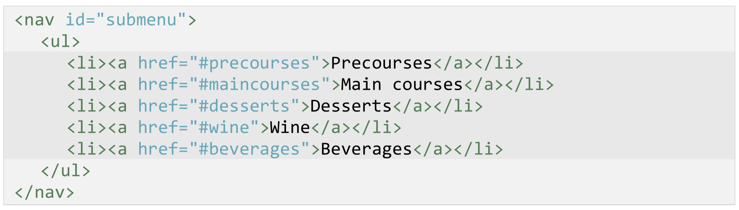
Notes:
Bookmarks and anchors provide a method to navigate *internally* on a page via a link menu. A bookmark is created simply with an ”id” attribute put on chosen elements. The link that will link to this bookmark, is then started with a ”#” symbol. The page will now scroll down to this id at click.

Slide 64
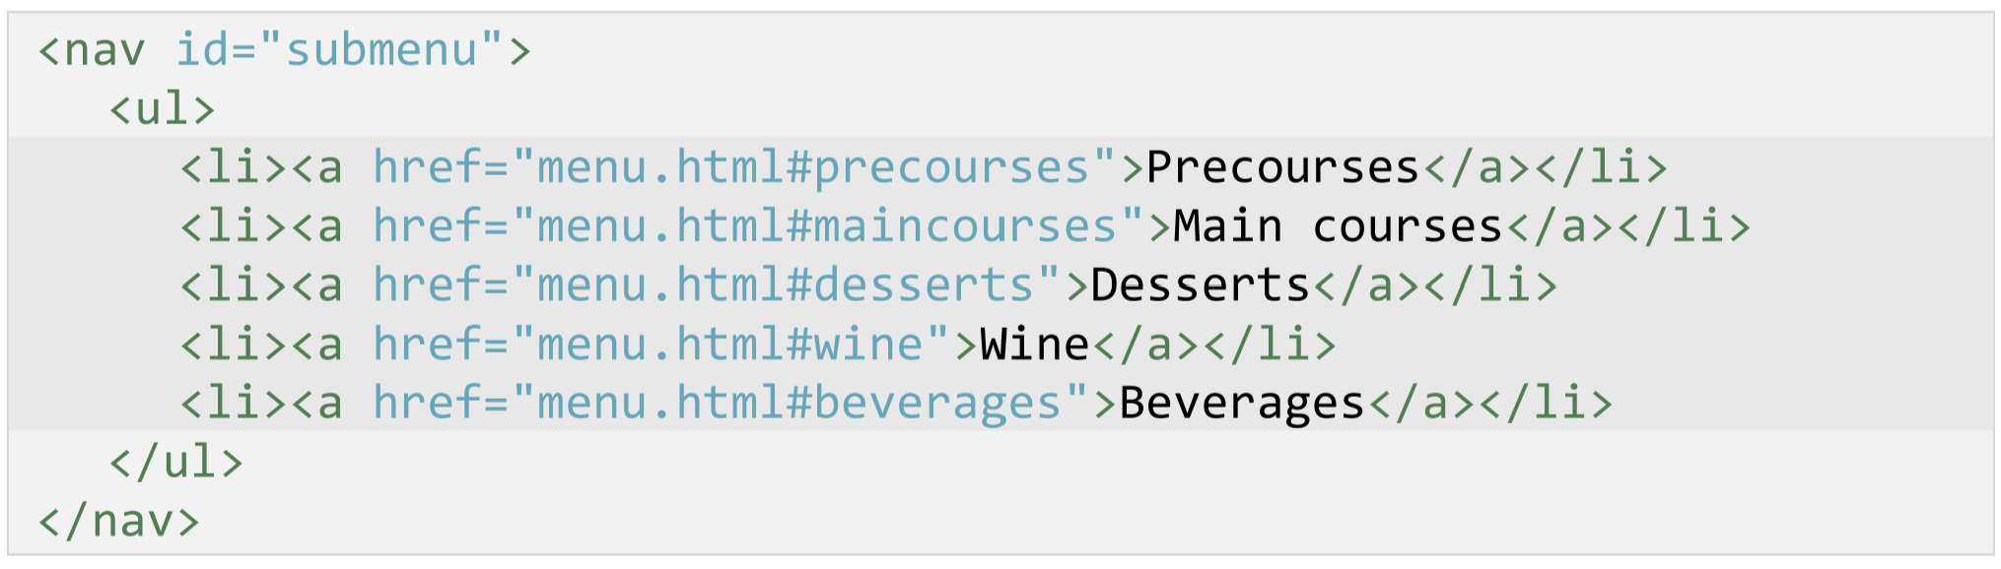
Notes:
If you link to bookmarks in other files, the link first must point towards the file and then subsequently being added the ”#” symbol in order to point to that bookmark in that file.

Slide 65
Pseudo-elements

Slide 66
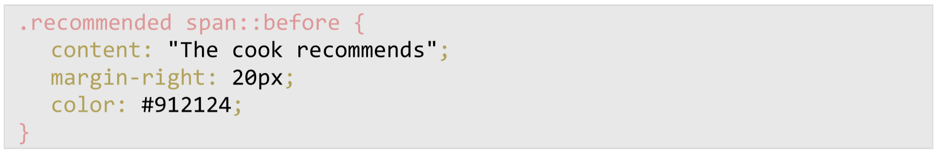
Notes:
Text content can be added via css alone by the use of special selectors initiated with a double colon ”::”. These are called pseudo-elements. Browsers usually accept the use of single colons ”:”, just like for pseudo-classes, but this is not a future-proof way of doing it as the standard defines them with ”::”.

Slide 67
Pseudo-classes reach Pseudo-elements create a
existing elements "virtual" element and reach that one
:hover ::before
:visited ::after
:first-class ::first-line
… …
Notes:
A pseudo-class reaches an existing element. It reaches an action (:hover), status (:visited, :focus), special conditions and relations (:first-class) and the like on this already existing element.
A pseudo-element has no elemen to reach. So, it first must ”create” a ”virtual” element, so to say, and then reach that one. Thus the name pseudo-*element*, that being a virtual, non-existing element that is just created on the fly by css. This can thus reach the ”space” immediately before or after an element with :before and :after.

Slide 68
content: "The cook recommends"; The cook recommends
content: "The cool<br>recommends"; The cook<br>recommends
Notes:
The ”content” property belongs to the :before and :after selectors only. Note that you can’t add code via this property. For instance html code will just be written out as clear text.

Slide 69
The website in html and css
End of course.

